Slide 1
Breakup reactions in R-matrix analyses
Mark Paris
Theoretical Division
Nuclear & Particle Physics, Astrophysics & Cosmology (T-2)
Bayesian Analysis of Nuclear Dynamics (BAND) Nuclear Data Workshop
Ohio University (Dublin, Ohio)
2024-12-17
LA-UR-24-33183

Slide 2

Outline
Introduction & Motivation
$2→2$ / Formalism / Code / Results
$2→3$ / Formalism / Code development / Results (preliminary)
Outlook

Slide 3



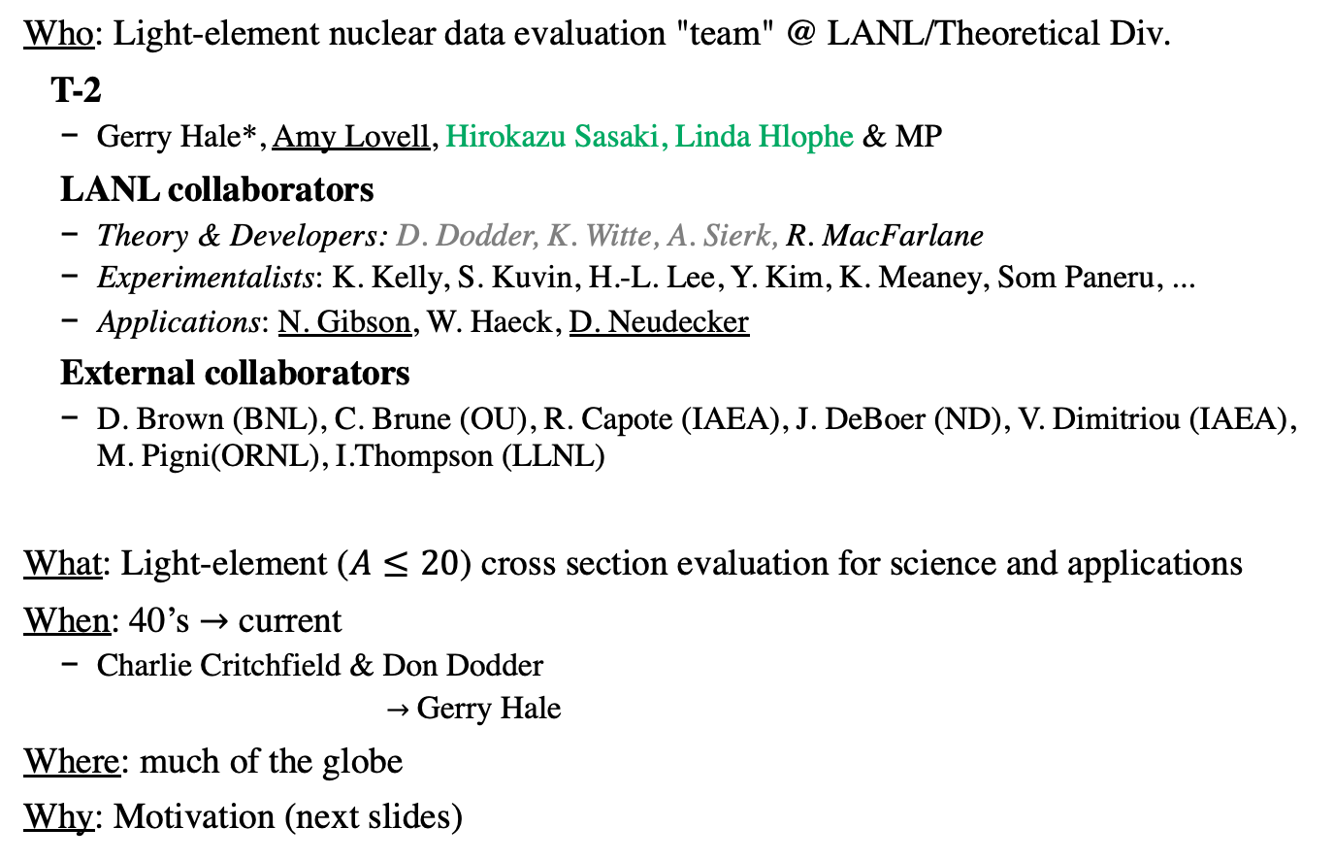
Introduction
Collaboration
Who: Light-element nuclear data evaluation "team" @ LANL/Theoretical Div.
T-2
Gerry Hale*, Amy Lovell, Hirokazu Sasaki, Linda Hlophe & MP
LANL collaborators
Theory & Developers: D. Dodder, K. Witte, A. Sierk, R. MacFarlane
Experimentalists: K. Kelly, S. Kuvin, H.-L. Lee, Y. Kim, K. Meaney, Som Paneru, ...
Applications: N. Gibson, W. Haeck, D. Neudecker
External collaborators
D. Brown (BNL), C. Brune (OU), R. Capote (IAEA), J. DeBoer (ND), V. Dimitriou (IAEA), M. Pigni(ORNL), I.Thompson (LLNL)
What: Light-element ($A≤20$) cross section evaluation for science and applications
When: 40’s $→$ current
Charlie Critchfield & Don Dodder
$→$ Gerry Hale
Where: much of the globe
Why: Motivation (next slides)
*5 decades at LANL!

Slide 4
LANL light-element program
Many compound systems A<20 (and a few above)
¹¹B (𝛼+⁷Li, 𝛼+⁷Li*, t+⁸Be, n+¹⁰B); ¹¹C (𝛼+⁷Be, p+¹⁰B)
¹²C (𝛼+⁸Be, p+¹¹B)
¹³C (n+¹²C, n+¹²C*)
¹⁴C (n+¹³C)
¹⁵N (p+¹⁴C, n+¹⁴N, 𝛼+¹¹B)
¹⁶O (g+¹⁶O, 𝛼+¹²C)
¹⁷O (n+¹⁶O, 𝛼+¹³C)
¹⁸Ne (p+¹⁷F, p+¹⁷F*, 𝛼+¹⁴O)

Slide 5
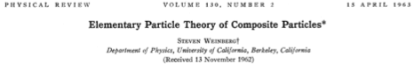
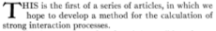
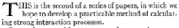
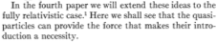
Motivation I
Weinberg’s ‘missing’ 4th paper
Theoretical
Address open problem of relativistic, multichannel scattering/reactions of composite strongly interacting (QCD) objects (a.k.a., nuclei)
??? The 4th paper never appears
Phenomenological R-matrix parametrization of light-element scattering/reactions (largely non-relativistic) may give clues about the more general problem

Slide 6
Motivation II
Practical uses of phenomenology
Practical Applications
Continuous (and multi-group) representation of scattering/reaction data and its uncertainty quantification (UQ) is important for a variety of applications
Nuclear astrophysics & cosmology
Neutrinos and fundamental symmetries
IAEA Standards
Energy
Nuclear criticality & safety
Nuclear security

Slide 7
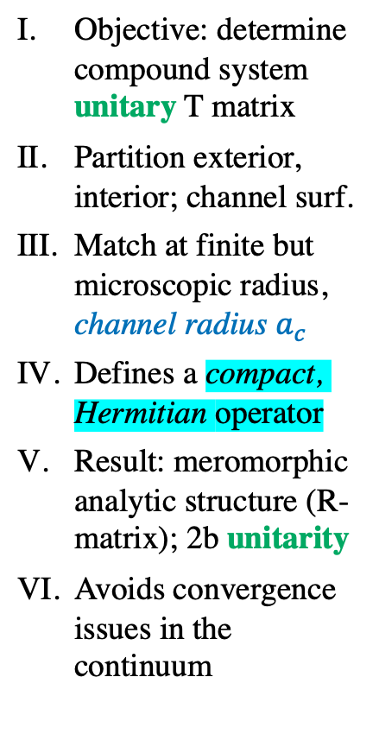
Theory
Wigner & Eisenbud (1940’s); Bloch (1957)
Objective: determine compound system unitary T matrix
Partition exterior, interior; channel surf.
Match at finite but microscopic radius, channel radius $a_{c}$
Defines a compact, Hermitian operator
Result: meromorphic analytic structure (R-matrix); 2b unitarity
Avoids convergence issues in the continuum
Compound system & channels
⁵Li – interior region
p+⁴He, d+³He, ... – exterior, asymptotic region

Slide 8
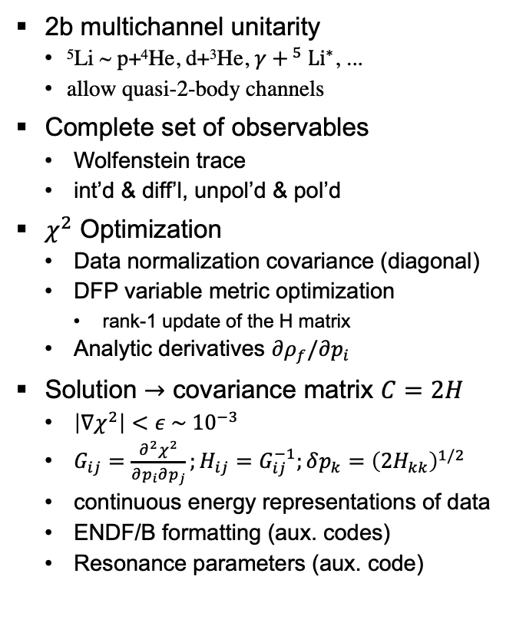
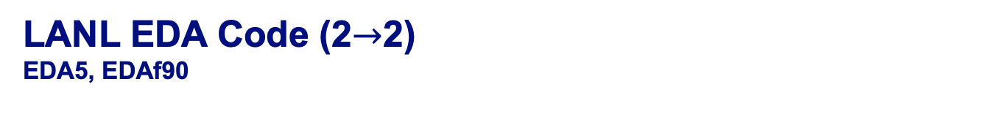
LANL EDA Code (2$→$2)
EDA5, EDAf90
2b multichannel unitarity
⁵Li ~ p+⁴He, d+³He, $γ+^{ 5}{Li}^{∗}$, ...
allow quasi-2-body channels
Complete set of observables
Wolfenstein trace
int’d & diff’l, unpol’d & pol’d
$χ^{2}$ Optimization
Data normalization covariance (diagonal)
DFP variable metric optimization
rank-1 update of the H matrix
Analytic derivatives $∂ρ_{f}/∂p_{i}$
Solution $→$ covariance matrix $C=2H$
$\left|∇χ^{2}\right|<ε \sim { 10}^{−3}$
$G_{ij}=\frac{∂^{2}χ^{2}}{∂p_{i}∂p_{j}};H_{ij}=G_{ij}^{−1};δp_{k}={\left(2H_{kk}\right)}^{1/2}$
continuous energy representations of data
ENDF/B formatting (aux. codes)
Resonance parameters (aux. code)

Slide 9
Current code versions
Previous version EDA5
Versatile, numerically stable; legacy [F66 remnants] → difficult to modify/debug
Current version EDAf90
ModernFORTRAN(F90)implementation
Identical numerically to EDA5
Interfaces with NJOY2016/NJOY21
Backend interface with ENDFtk
Frontend (observed data) interface with EXFOR/CSISRS (c5 format)
Release version cEDAR
This year

Slide 10
R-matrix evaluation ⁵Li system

Slide 11
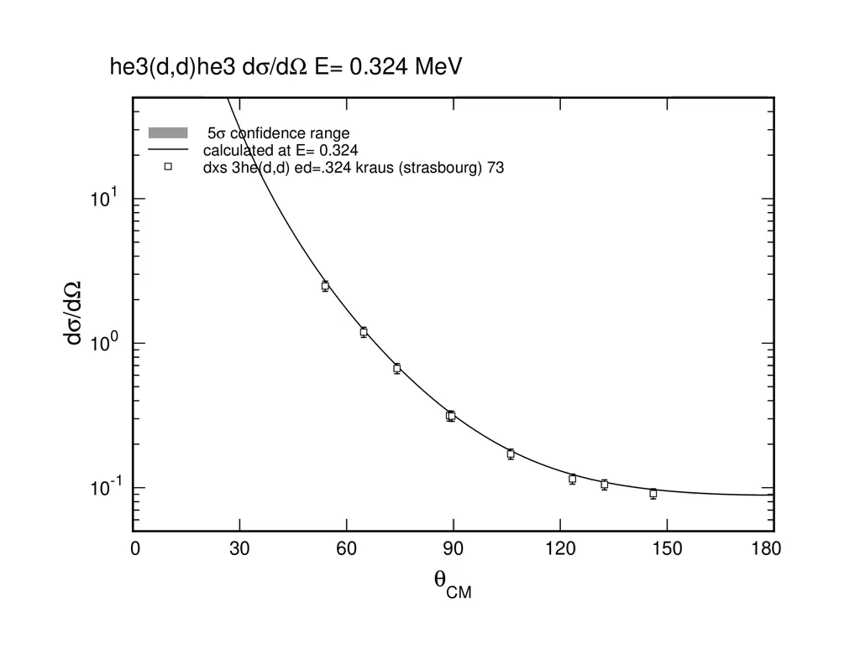
⁵Li system evaluation ³He(d,d)³He; ³He(d,p)⁴He; ³He(d,p)⁴He*; ⁴He(p,p)⁴He

Slide 12
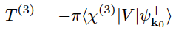
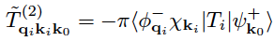
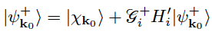
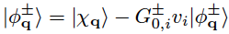
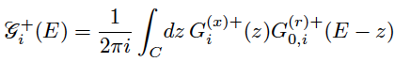
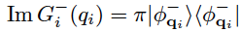
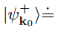
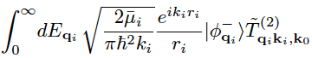
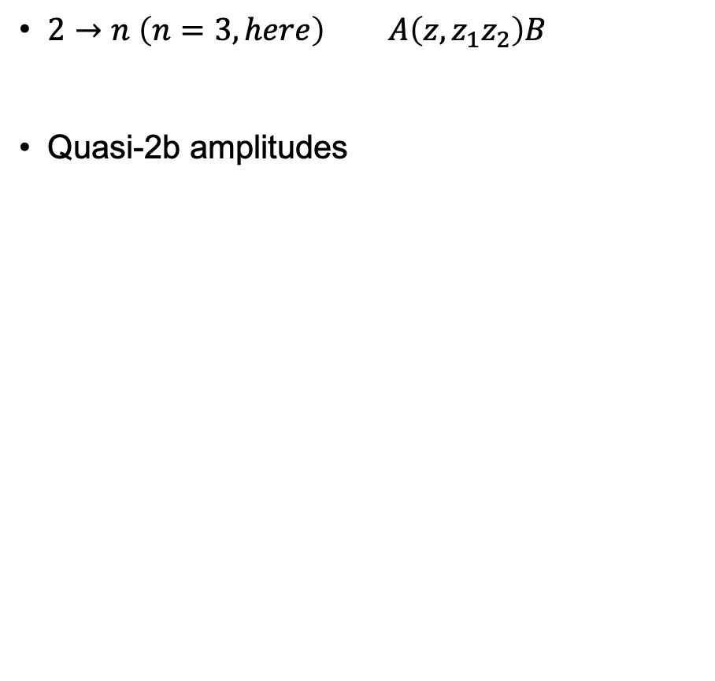
Breakup reactions
$2→n \left(n=3, here\right)$ $A\left(z,z_{1}z_{2}\right)B$
Quasi-2b amplitudes

Slide 13
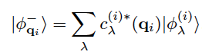
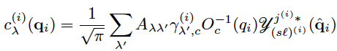
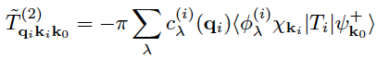
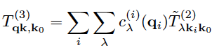
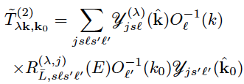
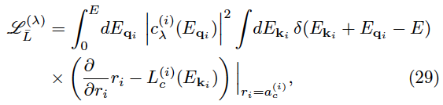
Breakup reactions

Slide 14
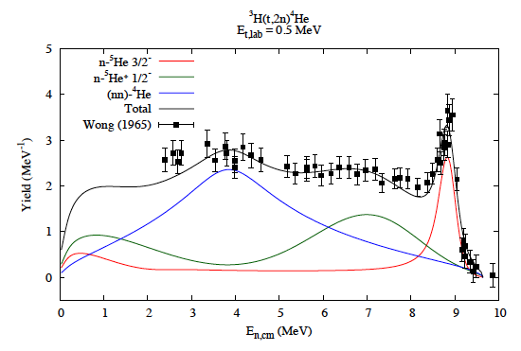
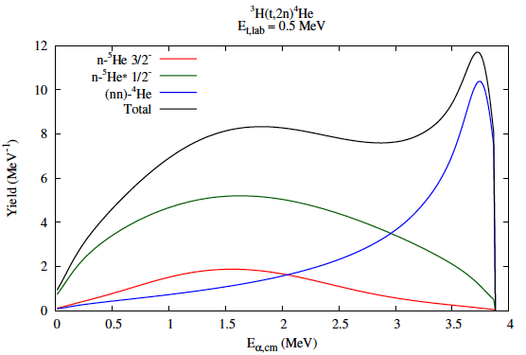
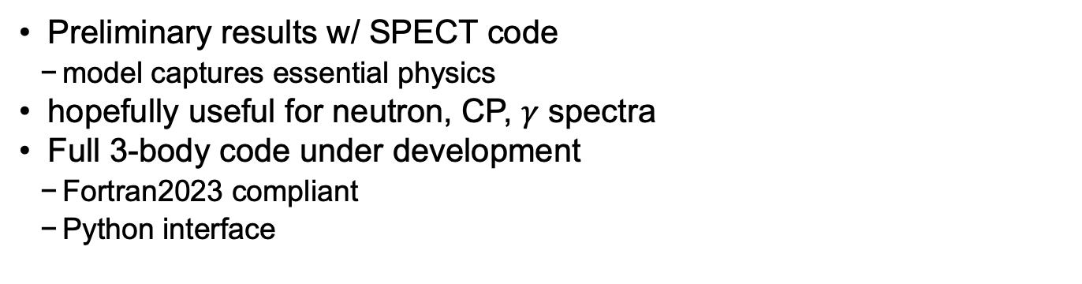
Breakup spectra ³H(t,2n)⁴He
Preliminary results w/ SPECT code
model captures essential physics
hopefully useful for neutron, CP, $γ$ spectra
Full 3-body code under development
Fortran2023 compliant
Python interface

Slide 15
Outlook
Completing code modernization & improvement
Fortran2023; utilizing polymorphism (classes) for handling multiple compound systems
Higher energies → break-up reactions
Currently post-processed by auxiliary codes
Immediate objective: (z,z'n), (z,z'𝛾), etc.
Uncertainty quantification
Currently
𝝌² minimization with per-experimental setup normalization
Appears sufficient for 2⟼2 body scattering/reactions, single compound system
New implementation
Bayesian statistical methods
Data covariances
Several compound systems concurrently
Ongoing/planned evaluation
¹⁰Be, ¹⁷O
Neutrons on H, C, N, O
Thank you for your patience and attention.

Slide 16
Thank you!

Slide 17
Theory
Bloch-Green formalism
Algebraic mnemonic
Operators ~ Matrices
Solve the multichannel, scattering equation
Matching @ r_{c} = a_{c}:
Definition of R-matrix and S-matrix

Slide 18
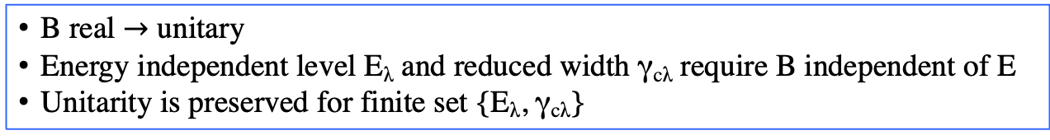
Theory
Bloch-Green formalism: S-matrix unitarity
B real $→$ unitary
Energy independent level E_{λ} and reduced width γ_{cλ} require B independent of E
Unitarity is preserved for finite set {E_{λ}, γ_{cλ}}

Slide 19
Unitarity implications
Implications of unitarity constraint on transition matrix
Doesn’t uniquely determine T_{ij}; highly restrictive, however
Elastic: (assuming T & P invariance)
Multichannel:
Unitarity violating transformations
Scaling single ampl:
Phase x-form:
consequence of linear ‘LHS’ quadratic ‘RHS’
Unitary parametrizations of data provide constraints that experiment may violate
normalization, in particular
¹⁷O: Bair & Haas '73 vs. Harissopulos '05
ENDF/B-VIII.0 release: Nucl. Data Sheets 148 (2018) 1–142

Slide 20
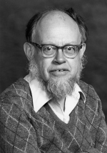
Theory
Unpolarized & polarized scattering/reaction observables
Wolfenstein trace formalism
Spin density matrix
Unpolarized
General polarization
Lincoln Wolfenstein
1923-2015

Slide 21
R-matrix parametrization
Relativistic kinematics
Mandelstam s variable
Lorentz invariant
Channel invariant
Relativistic parametrization form (reference channel c₀)

Slide 22
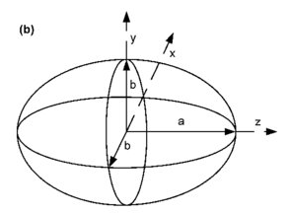
Parameter uncertainty from 𝜒²
The Old Way gives too-small uncertainty
At a solution:
Variations at :
Change in 𝜒² when {p₂} change, re-optimize 𝛿𝜒² w.r.t. {p₁}
: restriction of C to {p₂}-subspace
NB: the hypersurface’s average distance shrinks with incr. N_{p}

Slide 23
Parameter variance
At a solution
Assuming a normal distribution
Change in chi-squared
NB: adding redundant params can lower

Slide 24
Uncertainties from chi-squared minimization
Uncertainty determination comparison:
1)
previous:
2)
improved:
Better scaling:

Slide 25
Observable error propagation
Covariance matrix
The parameter covariance matrix is , and so first-order error propagation gives for the cross-section covariances
observable uncertainties
correlation coefficient

Slide 26
NN system covariance data
Covariance matrix

